Slide 1

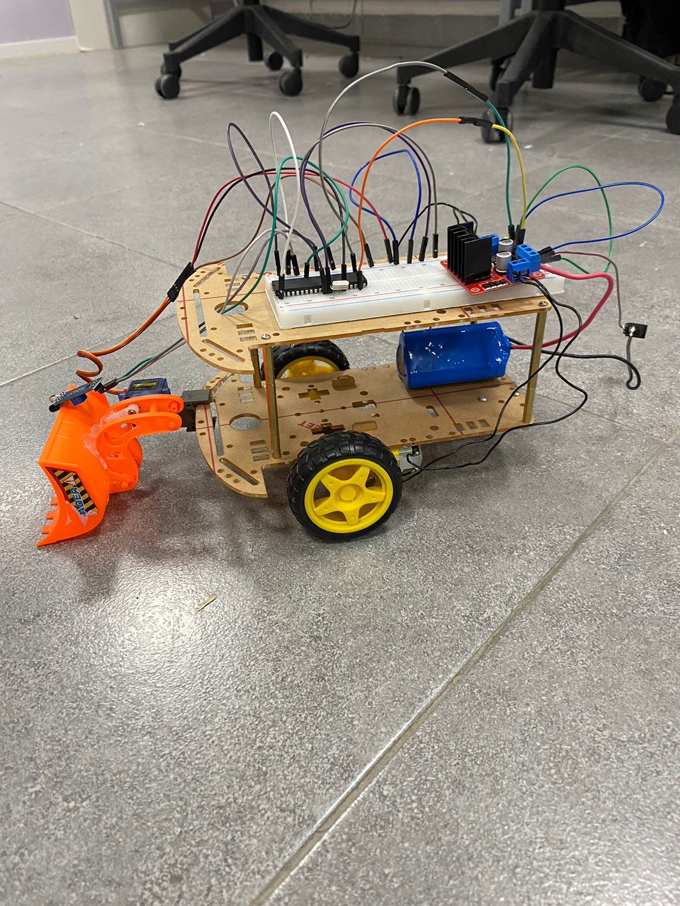
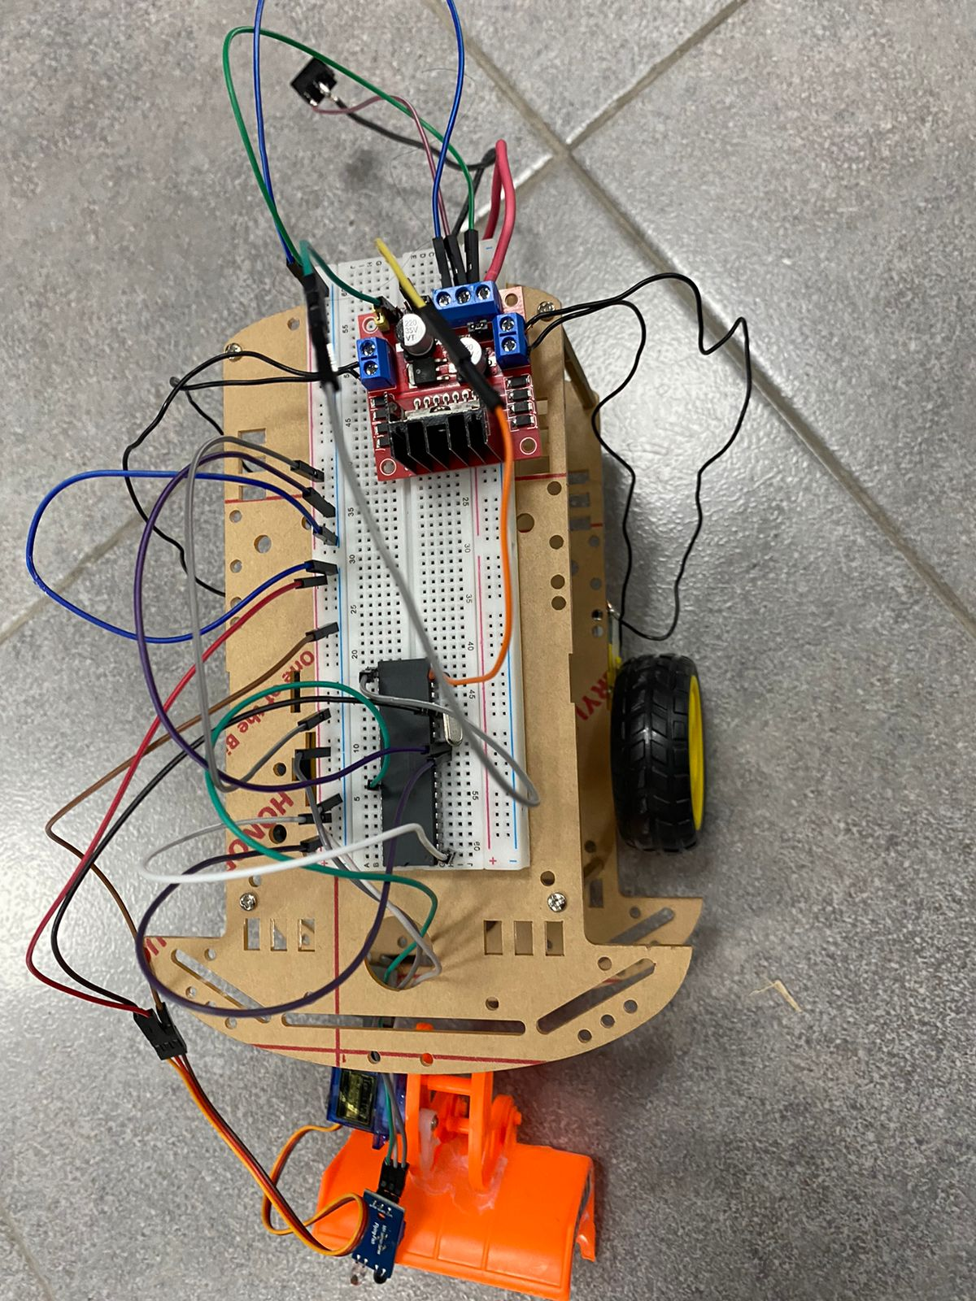
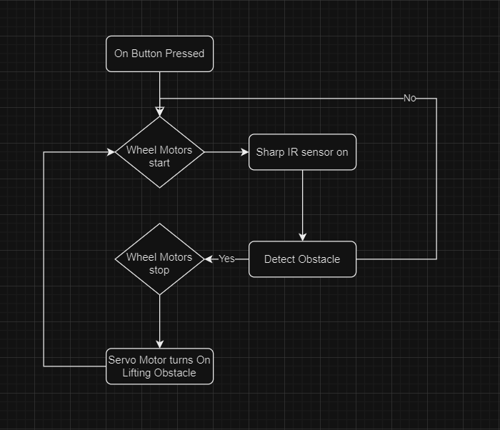
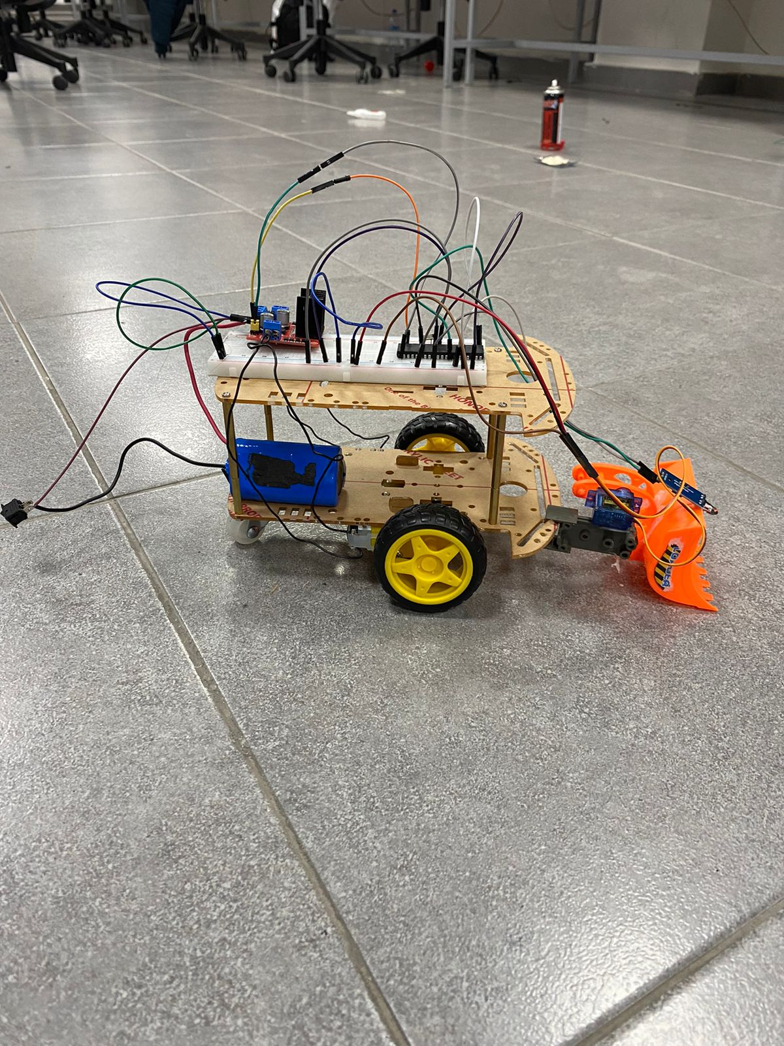
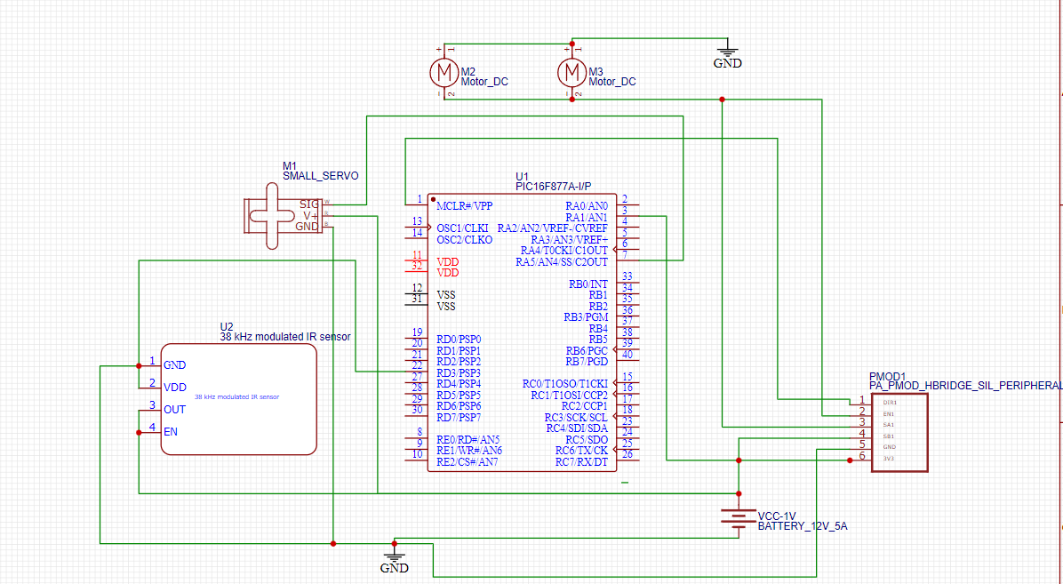
Obstacle Removing Robot
Qutaiba Hamdan
Supervisor: Dr. Belal Sababha Embedded Systems Final Design Project, Fall 2023
King Abdullah II School of Engineering Princess Sumaya University for Technology
Introduction
This project aims to design an obstacle removing robot using one PIC16F877A microcontroller. The robot has a lifting arm controlled by a servo motor. The main sensor and component used were a Sharp IR sensor in addition to a H-Bridge . The primary objectives of this project are twofold: first, to design a sophisticated robotic system capable of effectively detecting obstacles using a Sharp IR sensor; and second, to implement a robust lifting mechanism using a servo motor for obstacle removal. The scope of the project encompasses the integration of key components, including the PIC16F877A microcontroller, the Sharp IR sensor, and the servo motor, to create a seamless and efficient obstacle-removing robot.
Results
The following figures depict the final results after connecting the circuits.
Design
The following flowchart provides an insight of the functionality of the main device in the smart city, which is the car.
Start
Front Figure
(b) Project shown from above
Figure 1
The designed circuit is shown in Figure 2.
(c)
( c ) Side view of project
Conclusion
In conclusion, the obstacle-removing robot project has achieved its primary objectives and demonstrated a promising foundation for future advancements. The identified challenges provide valuable insights for iterative refinement, paving the way for a more robust and versatile robotic system capable of overcoming a wider range of obstacles in real-world scenarios.

